Slide 1

Construyendo aplicaciones Media con Microsoft Azure Media Services
Mariano Vazquez
mariano.vazquez@southworks.net
@marianodvazquez
Software Developer
Southworks
Mariano Converti
mariano.converti@southworks.net
@mconverti
Technical Lead
Southworks

Slide 2



Agenda
Introducción
Conceptos de Media en general
Arquitectura de Microsoft Azure Media Services
Principales Características
Video-on-Demand (VOD)
Live Streaming
Dynamic Packaging
Dynamic Encryption (secure delivery)
Demos
Video-on-Demand (VOD) Media workflow (básico)
Live Streaming Media workflow (básico)
Nuevas Características (Preview)
Live Encoding
Dynamic Manifests
Rendered Sub-Clips

Slide 3
Introducción

Slide 4

Conceptos de Media en general
Progressive Download vs. Adaptive Streaming
Protocolos de Adaptive Streaming: HTTP vs. non-HTTP
Transcoding vs. Transmuxing (Packaging)
Digital Right Management (DRM)

Slide 5




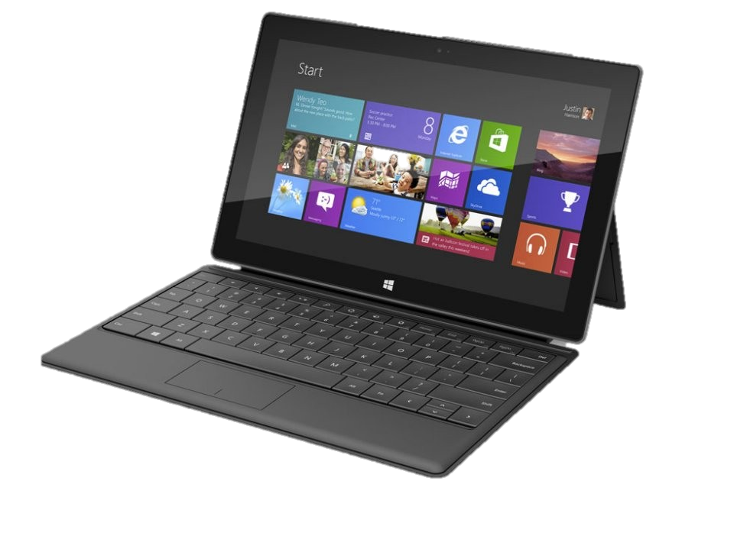
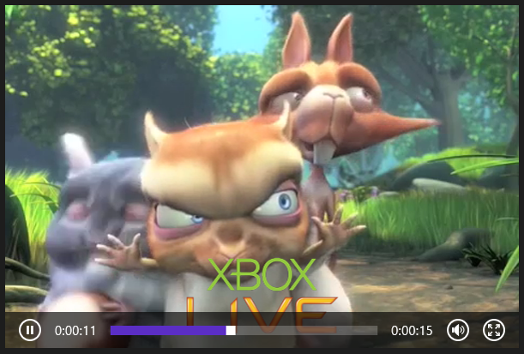




Desafíos
Costos de infraestructura
Costos de administración
Monetización de contenidos
Digital Rights Management
Seguridad
Videos de alta calidad para cualquier dispositivo
en cualquier lugar y en cualquier momento
Ágil,
Escalable,
Rentable
Múltiples formatos, multiples bitrates

Slide 6



















Arquitectura
“Build-On” Media Partners and Customers
Partner CDNs
REST APIs
iOS
Azure Media Services
XBOX 360
Secure
Media Ingest
Encoding
On-Demand
Origin
Live Ingest
Live Origin
Advertising
HTML 5
Media Job
Scheduling
Static/Dynamic Packaging
Content Protection
Live Encoding
Analytics
Identity Management
Windows
Phone
Azure CDN
Android
Partner Technologies (Media Processors, Origin Servers, Live Encoders etc.)
Flash
(Fabric, Storage, Compute, Database)
Origin
Adaptive Streaming
Porting Kits
Caching
Released
Preview
Coming Soon
Partners

Slide 7
Principales Características

Slide 8







Carga
Encoding
Packaging
Encriptación
Distribución
Video-on-Demand

Slide 9


Paso #1: Carga de Contenidos
ASSET
INGEST
Azure Blob Storage
Diferentes opciones de carga de contenidos (mezzanine)
Pre-encriptación de archivos antes de la carga (AES 256)
Carga segura mediante HTTPS
Carga rápida con UDP usando Aspera
Soporte para múltiples Storage accounts

Slide 10
Paso #2: Encoding, Packaging, Encriptación
Queue
Encode
Azure Blob
Azure Blob

Slide 11
Paso #2: Encoding, Packaging, Encriptación
Encoding Units
Encode
Encode
Azure Blob
Azure Blob
Encode
Azure Media Encoder
Soporte para H.264, VC-1 video encoding
Soporte para AAC-LC, HE-AAC, Dolby DD+, WMA audio encoding
Packaging a MP4, Smooth Streaming, Http-Live-Streaming
Encriptación con PlayReady, Common Encryption, AES
Otros Media Processors disposibles:
Azure Media Indexer

Slide 12
Paso #3: Distribución de Contenido
Asset
Encode
Stream
Ingest
Azure Blob
Origin Server
Servicio de Streaming manejado… funciona!
Ancho de banda garantizado
Auto recuperación, redundancia y failover
Soporte para múltiples origins con escalamiento independiente
Soporte para Azure CDN y 3rd party providers
IP Whitelisting

Slide 13
Dynamic Packaging

Slide 14




Static Packaging (Tradicional)
Package
HLS
Encode
Package
Video Sources
Multi-bitrates MP4
Smooth
Streaming
Origin Server

Slide 15


Dynamic Packaging
Permite reutilizar el contenido ya encodeado y distribuirlo en varios formatos de streaming sin repackaging
Origin Server
Dynamic
Packaging
HLS
Encode
Smooth
Streaming
Video Sources
Multi-bitrates MP4
DASH
Formato de entrada: MP4 o Smooth Streaming
Formato de salida: Smooth Streaming, Http-Live-Streaming (v4 and v3), MPEG-DASH
Dynamic packaging requiere por lo menos 1 streaming unit en el Origin Server!

Slide 16
Dynamic Encryption

Slide 17

Opciones Disponibles
Prevent “man-in-the-middle”
Encrypted
Encrypted
Encrypted
Encrypted
Encrypted
Encrypted
Encrypted
AES clear key
dynamic encryption
DRM technology
+ licensing agreement

Slide 18
Opciones Disponibles
AES Clear Key dynamic encryption
Encrypt on-the-wire communication using the widely-known symmetric AES encryption algorithm. An authentication service for key is provided.
Who should use this feature:
“Trust your client”: Key is stored in clear format so it requires you to trust your client not to pass key around
Encriptación "Liviana" : previene el ataque "man-in-the-middle"
Costos más bajos comparados con una solución DRM
DRM technology (PlayReady)
Encrypt Smooth Streaming content with PlayReady protection via common encryption scheme (CENC), and the option of packaging it into HLS or DASH. DRM technology allows you to define restrictive licensing agreement to manage user access rights to your media.
Who should use this feature:
Contenido premium o de alto impacto de negocio: la decodificación sucede en un ambiente DRM seguro
Previene piratería y el ataque "man-in-the-middle"
Permite habilitar más modelos de negocio

Slide 19






Advanced Encryption Standard (AES)
Define:
Asset Delivery Policy: Dynamic Encryption
Content Key
Content Key Authorization policy
Token/IP/Open
Origin Server
Storage
HLS + AES (HTTP)
Smooth Streaming + AES (HTTP)
MP4/Smooth Streaming
MAMS - Key Services
Request key with token (HTTPS)
Client SDK
Return key if token verified (HTTPS)
Login
Token
verification
AES Key
Issue token
Customer’s Authz system

Slide 20
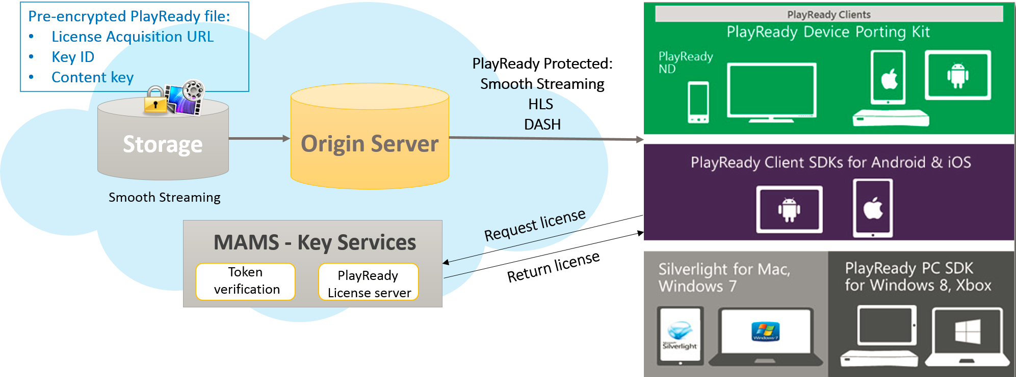
PlayReady DRM

Slide 21
Live Streaming

Slide 22


Live Streaming
Stream live content directly through public cloud
Multi-format output (Smooth Streaming, HLS and DASH)
Global reach – deploy anywhere quickly
Cloud elasticity
No capital expenses
Ramp quickly to global scale
Tear down immediately

Slide 23
Cómo funciona?
Ingest:
Ingest URL to accept Live streams with different bitrates (smooth streaming) through load balancer
Forwards the stream to all preview end-points
WA Load Balancer
Channel
INGEST
Preview:
Receives stream from Ingest
Forwards to Program
Exposes Preview URL (for monitoring and voice-over)
PREVIEW
Preview URL
PROGRAM
Program:
Writes it to Blob Storage for Live DVR and Archive
Dynamic package into HLS, Smooth and DASH
PROGRAM
Program URL
Blob Storage

Slide 24
Demos

Slide 25
Nuevas Características (Preview)

Slide 26
Recursos

Slide 27
Q&A

Slide 28
Muchas Gracias!

